Slide 1
Standard Deviations
John Westlund, Ragnar Hartmann, Hollis Barnett, Dominic Phan, and Tyler Tran
Notes:
Include an overview of the purpose of the challenge. What is the goal of the Flu Vaccine challenge:
https://www.drivendata.org/competitions/66/flu-shot-learning/page/210/

Slide 2
Overview
Overall Objective of the Flu shot Vaccine Challenge
Things Learned:
GitHub, Cleaning Data, Uploading notebook, teamwork, Coding (Python)
Hurdles:
Red box of death, Coding format, Data formatting for score
Solutions:
Code familiarizing, Code troubleshooting

Slide 3
Phase 1: Data Preparation
Converting Alphabetical Values to Numeric

Slide 4
Phase 1: Methods
Changed Alphabetical to Numerical
Custom Label Encoder: Ordinal
One Hot Encoder: Nominal
Ignored/removed rows with NaN values
Notes:
Hierarchical data refers to links between data: Son, Parent, Grandparent
https://www.tibco.com/reference-center/what-is-hierarchical-data
The two main categories of data are Ordinal and Nominal:
https://www.scribbr.com/statistics/ordinal-data/
-> Total data count = 6347 features
Features are the number of columns. The dataset has 36 columns. The first column respondent_id is a unique and random identifier. The remaining 35 features are what was used for prediction.
6347 is the number of rows or records of data available after your initial processing. I would also put how many total rows are in the training data set to begin with before the initial processing.

Slide 5
Phase 1: Results
12 features in the data set were Alphabetical Values
7 ordinal features
E.g., Education (4-year, high school, etc.)
5 nominal features
E.g., Race (White, Black, etc.)
Total data count = 6,347 Rows
Notes:
Hierarchical data refers to links between data: Son, Parent, Grandparent
https://www.tibco.com/reference-center/what-is-hierarchical-data
The two main categories of data are Ordinal and Nominal:
https://www.scribbr.com/statistics/ordinal-data/
-> Total data count = 6347 features
Features are the number of columns. The dataset has 36 columns. The first column respondent_id is a unique and random identifier. The remaining 35 features are what was used for prediction.
6347 is the number of rows or records of data available after your initial processing. I would also put how many total rows are in the training data set to begin with before the initial processing.

Slide 6
Phase 2: Data Prepation cont.
Handling NaN’s

Slide 7
Phase 2: Methods and Results
20,359 rows of data NaN’s
Imputed mean values for NaN’s
Mean AUC score
New data count = 26,706 Rows
Notes:
Mean imputation is often used when the missing values are numerical and the distribution of the variable is approximately normal.
Median imputation is preferred when the distribution is skewed, as the median is less sensitive to outliers than the mean.
Mode imputation is suitable for categorical variables or numerical variables with a small number of unique values.

Slide 8
Phase 3: AI/ML Training

Slide 9
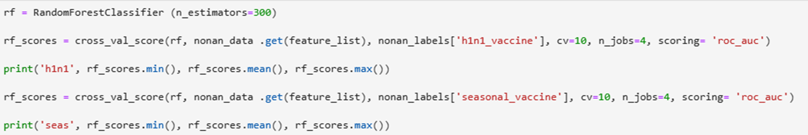
Phase 3: Methods
Imported 2 learning techniques for AI/ML model
Random Forest Classifier and Gradient Boosting Classifier
Imported Cros_Val_Score to evaluate performance of model

Slide 10
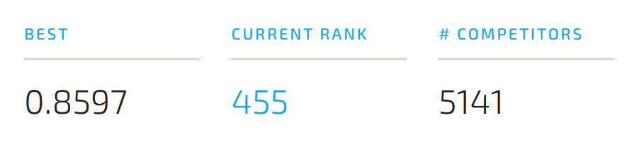
Conclusion: Model Success Rate
Notes:
Include output/screenshot from DrivenData subsmission?

Slide 11

Questions?

Slide 12
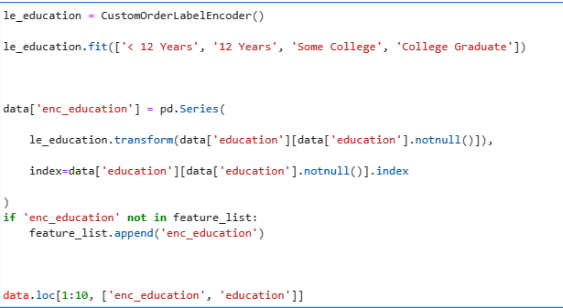
Custom Label Encoder
Notes:
What are you intending to talk about on this slide? Why you chose to use a Custom Label Encoder? This shows how it was used, but not the code of the encoder itself.

Slide 13
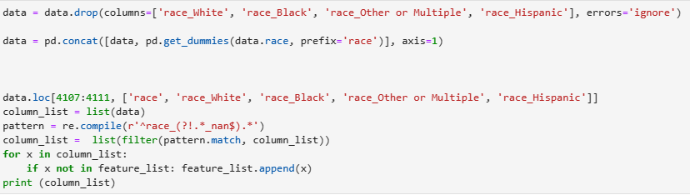
OneHot Encoded
Notes:
I would be careful with how many slides you have. You only have 10 minutes to talk. So unless these slides are really fast you may use a lot of your time on less valuable material.

